Slide 1

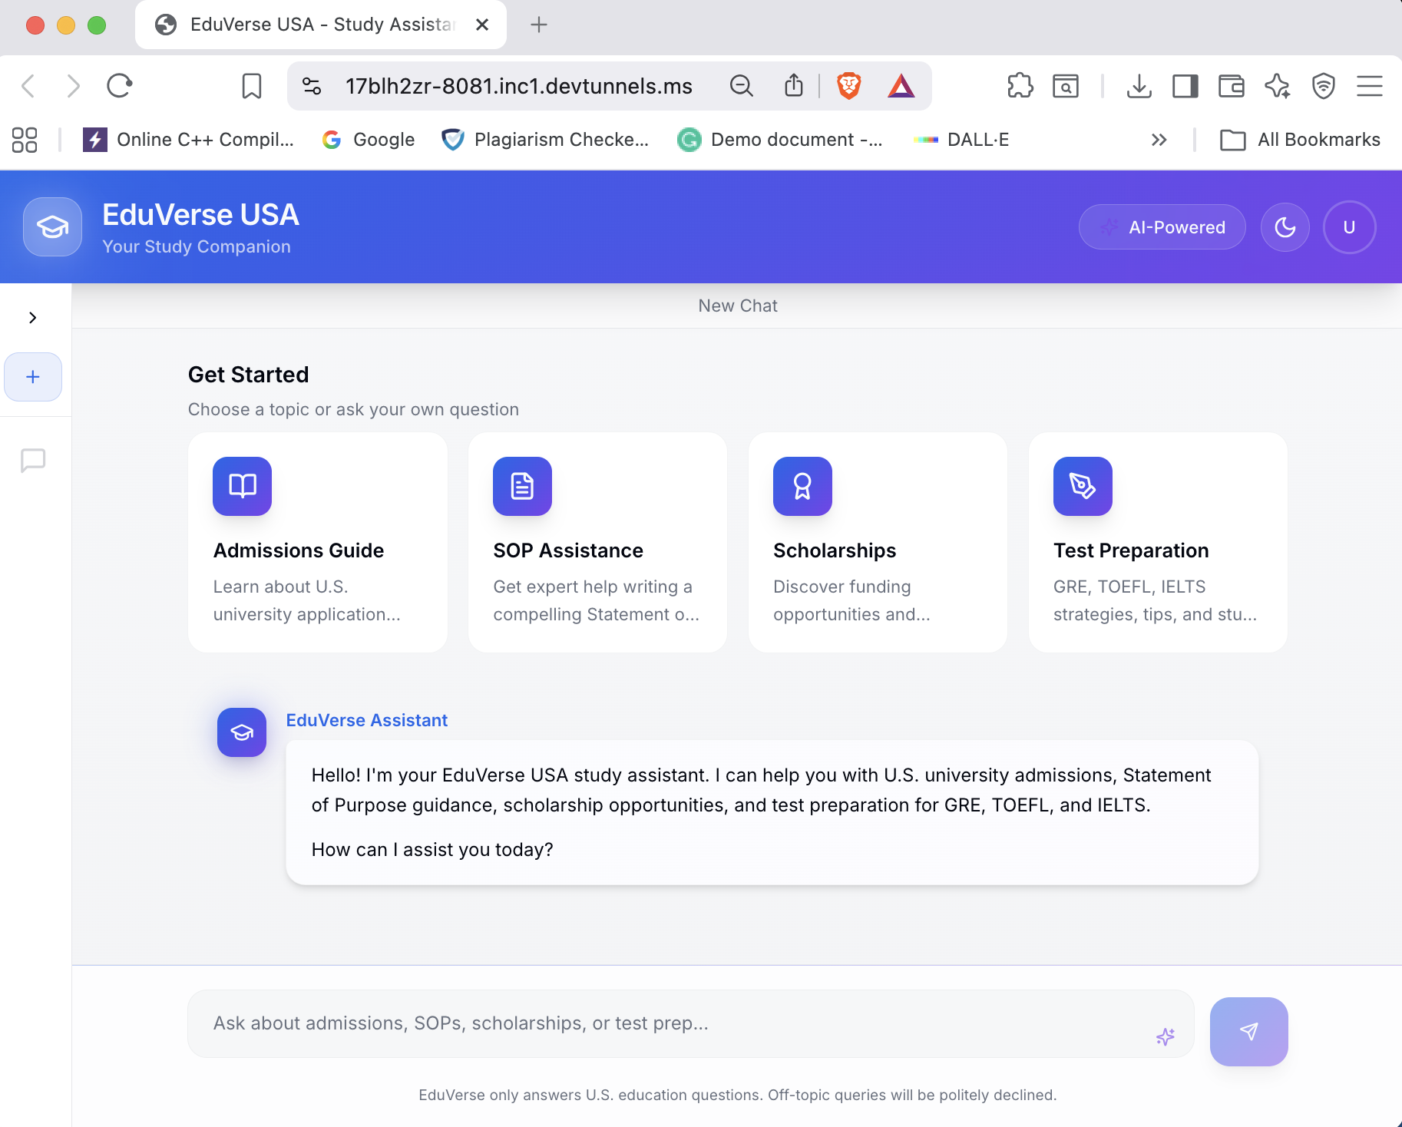





NLP COURSE PROJECT
6
EduVerse
Jupyter Notebooks
USA
3
AI-Powered Study Assistant for International Students
Python Files
University UCP
AI-Powered
Chatbot
Student
Muhammad Zafar UL Haq

Slide 2














Project Overview
University UCP
EduVerse USA
AI-Powered Study Assistant
Helping international students navigate U.S. university admissions with intelligent guidance
React + TypeScript
Frontend Framework
University Admissions
Supabase
Requirements & Deadlines
Database & Auth
SOP Writing
Google Gemini
Essay Guidance & Tips
Large Language Model
Scholarships
Funding & Opportunities
Loveable Cloud Development
React Frontend + Supabase Backend
Test Preparation
GRE, TOEFL, IELTS Support

Slide 3



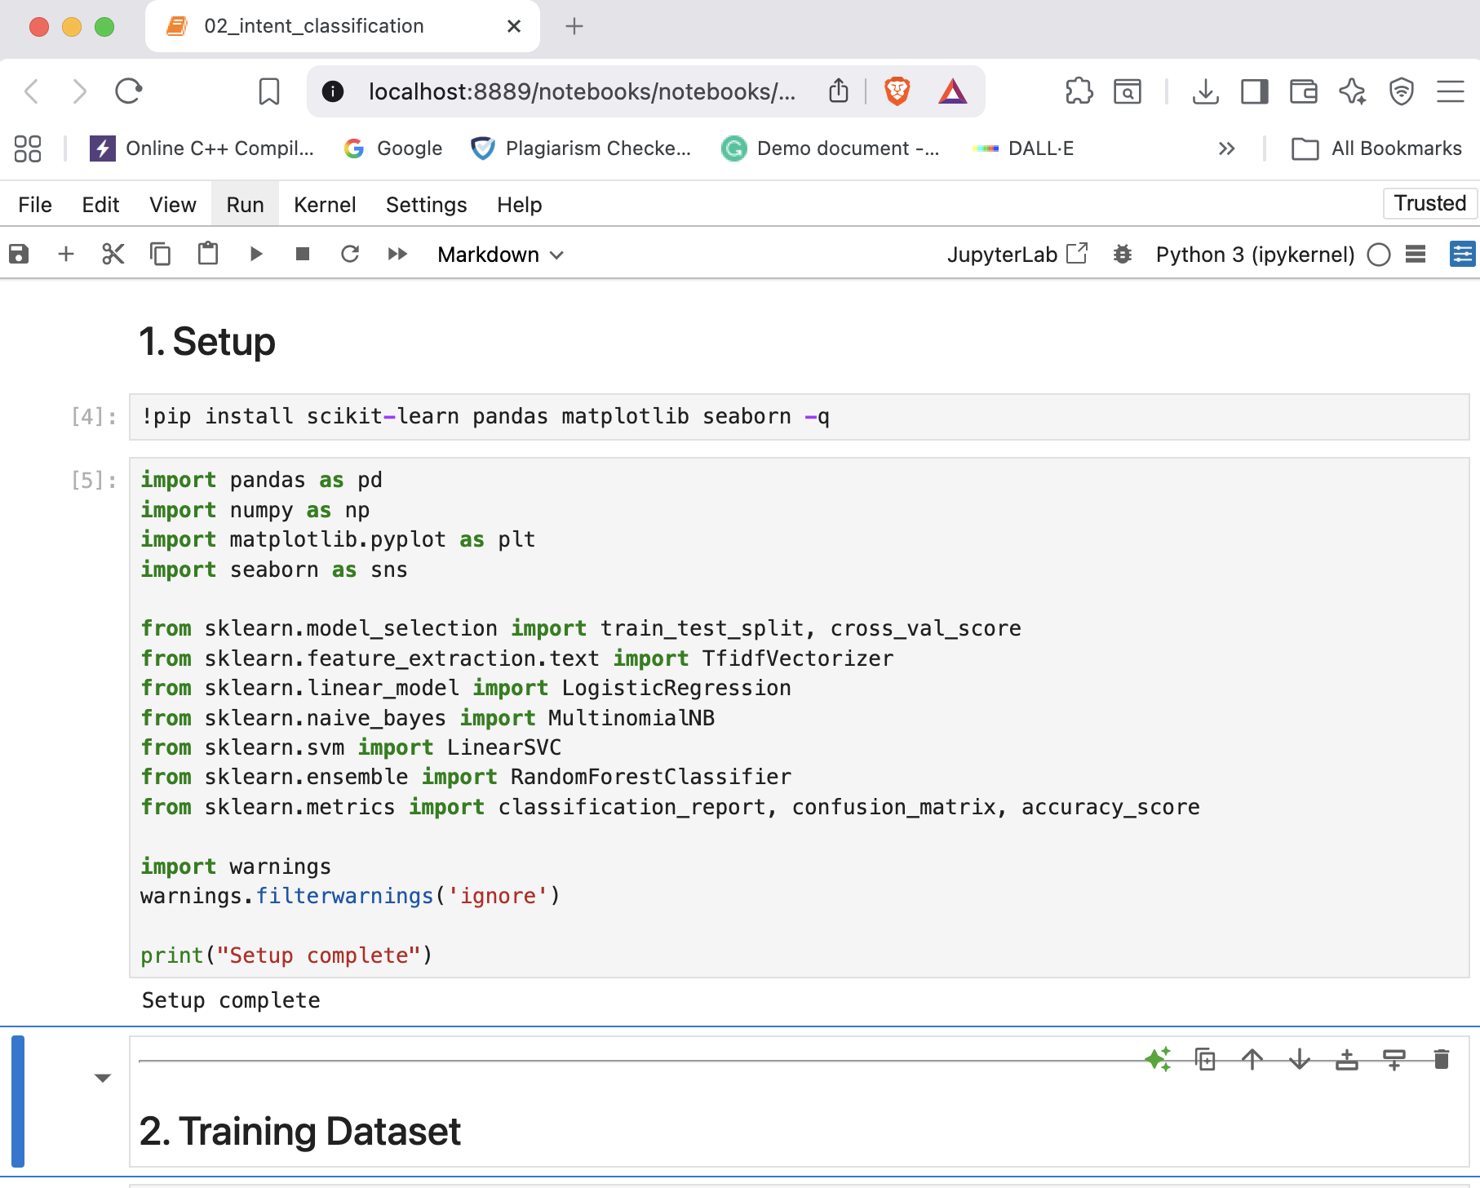






Jupyter Notebooks
6 Modules
NLP Pipeline Implementation
Text Preprocessing
Implementation Preview
1
Cleaning, tokenization, lemmatization
2
Intent Classification
TF-IDF + Logistic Regression
3
Named Entity Recognition
Rule-based NER with regex & gazetteers
4
Context Management
Dialogue state tracking
5
RAG Retrieval
Retrieval-Augmented Generation
Complete Pipeline
From Preprocessing to Response Generation
6
Response Generation
Response composition techniques

Slide 4


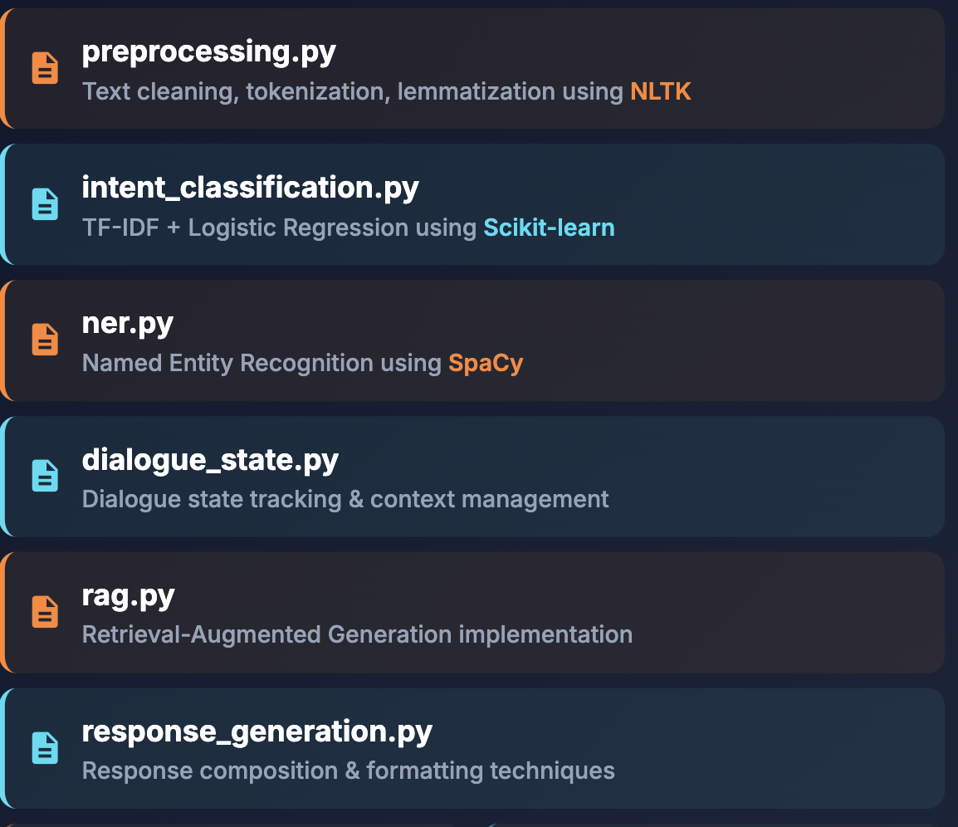







Python Files
6 Python Files
Key NLP Concepts
File Structure
preprocessing.py
Intent Classification
NER
Text cleaning, tokenization, lemmatization using NLTK
Query type ID
Entity extraction
intent_classification.py
Context Management
Domain Restriction
TF-IDF + Logistic Regression using Scikit-learn
U.S. education focus
Multi-turn dialogue
ner.py
Libraries Used
Named Entity Recognition using SpaCy
NLTK
Scikit-learn
SpaCy

Slide 5


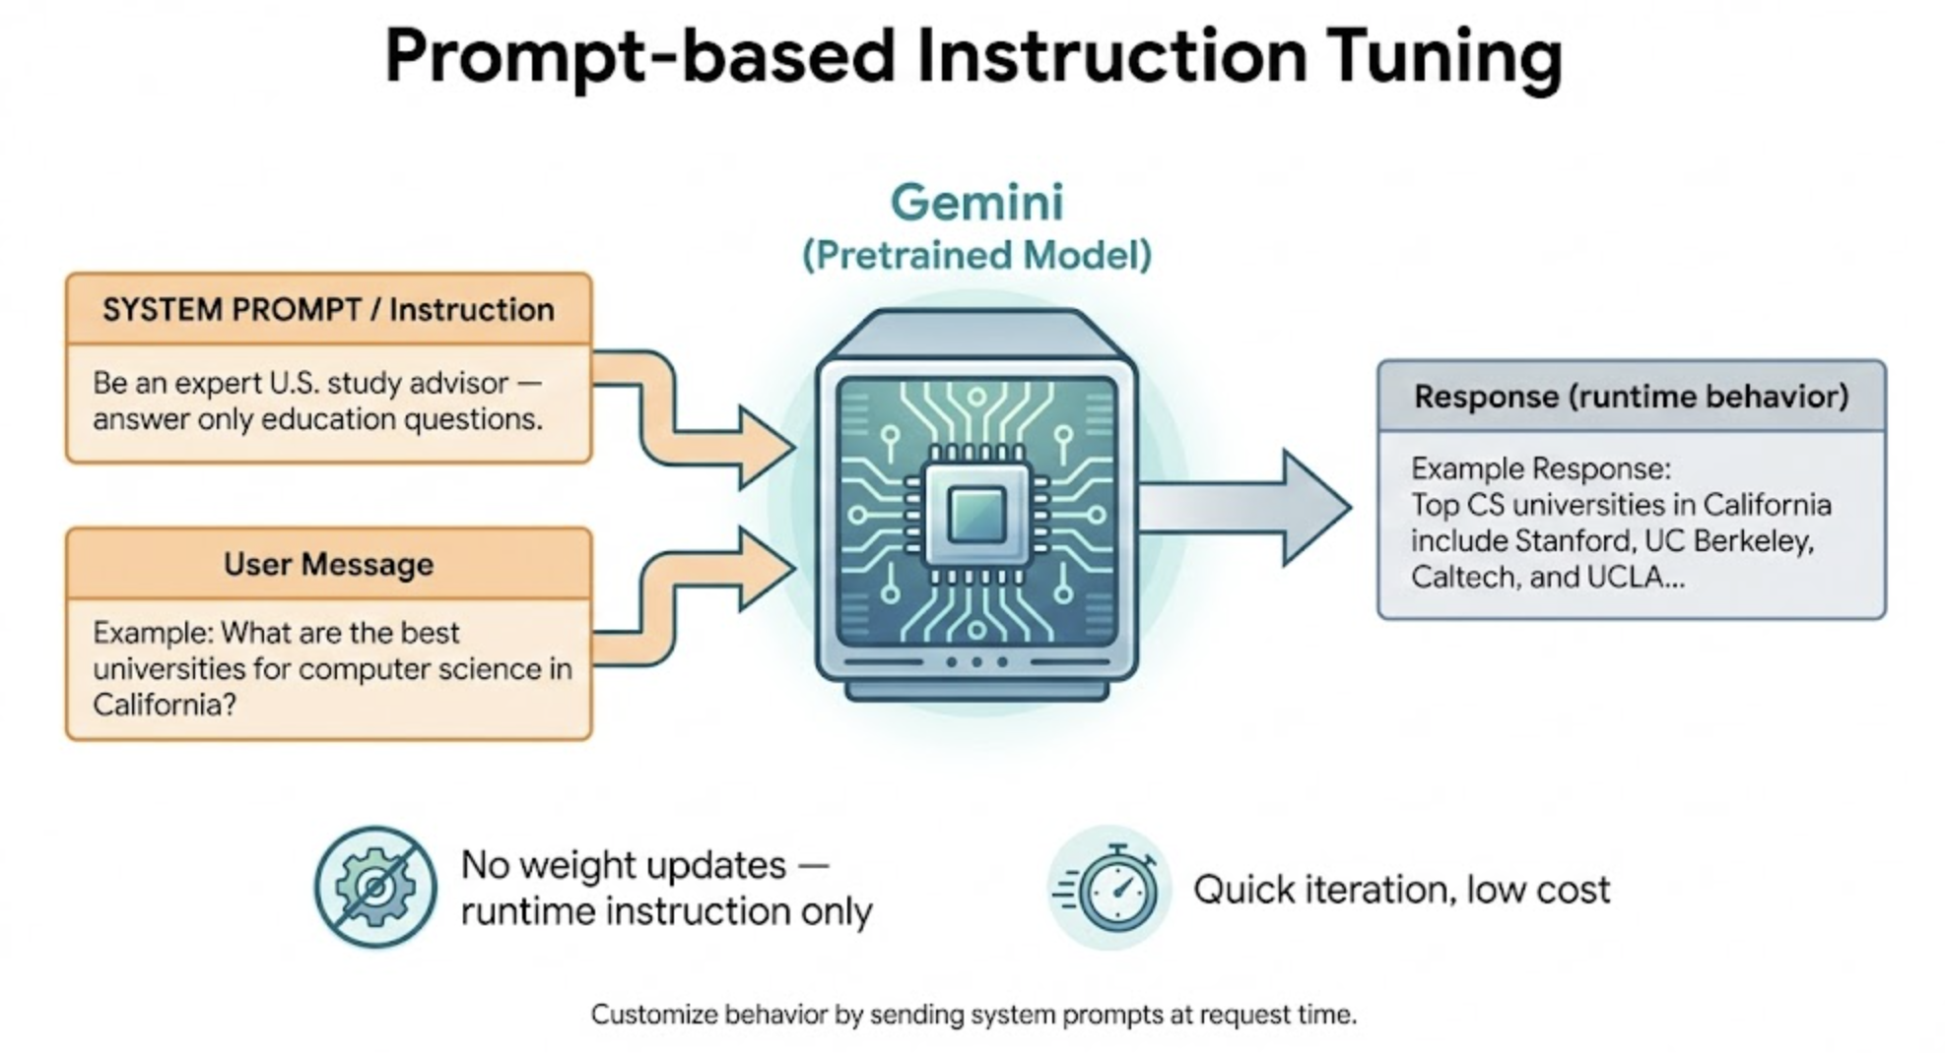







Fine-Tuning Process
Instruction Tuning
Instruction Tuning
Fine-Tuning Workflow
Customizing model behavior through detailed prompts instead of modifying weights
supabase/functions/chat/index.ts
const SYSTEM_PROMPT = "You are EduVerse USA, an expert NLP-based AI study assistant strictly focused on U.S. higher education..."
1
Define behavior rules
in system prompt
Intent Classification
NER
2
Apply scope restrictions
& instructions
Context Management
Domain Restriction
3
Generate contextual
grounded responses

Slide 6


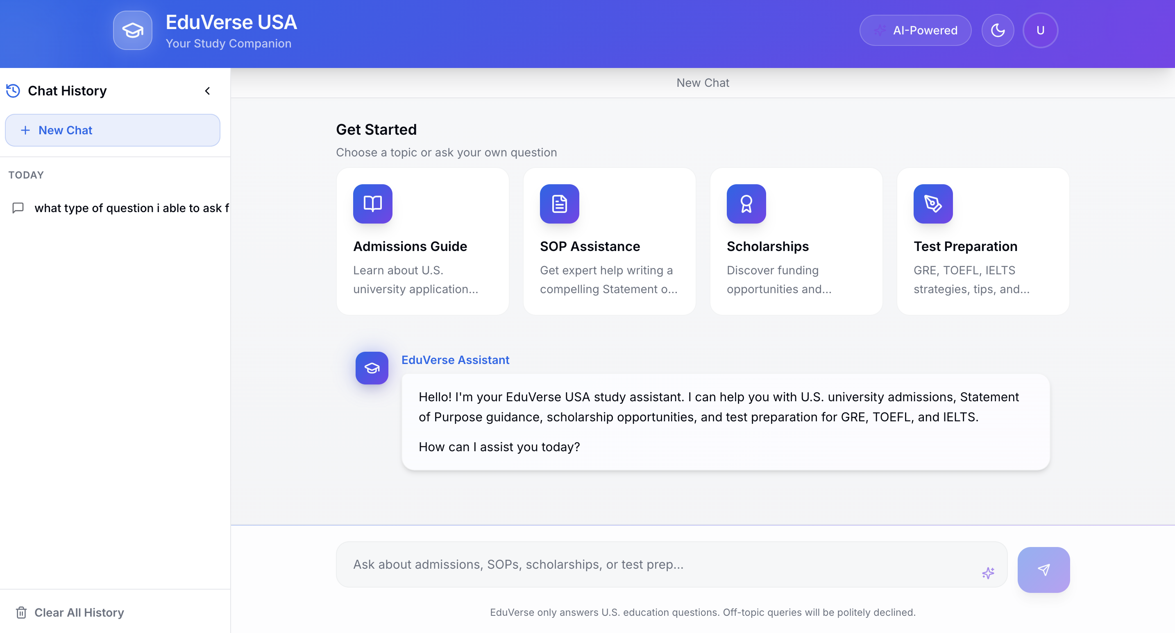







Frontend & Development
Development Environment
Loveable Cloud Frontend
React-based chat interface with real-time streaming capabilities
Chatbot Interface
Real-time Streaming
Authentication
Secure access
Instant responses
Chat History
Dark/Light Mode
Persistent storage
Toggle themes
Sanbaze (Supabase)
Database & Backend Service
PostgreSQL
Edge Functions
Loveable Cloud
Development Environment
Real-time Sync

Slide 7






Conclusion
University UCP
Project Achievements
Complete NLP pipeline with 6 Jupyter notebooks
Thank You!
Responsive React chat interface with real-time streaming
Muhammad Zafar UL Haq
University UCP
LLM integration with custom fine-tuning via prompts
NLP Course Project
Loveable cloud development with Supabase integration
EduVerse USA
Developed using Loveable Cloud for frontend and Supabase for backend integration
NLP
React + TypeScript
Python & ML
LLM Integration
Loveable Cloud

